Slide 1
Project 1: A study of test scores
Madhukar Mantravadi

Slide 2
What
Provided with a set of data containing participation rate and scores for SAT and ACT
Were tasked with analysis of the data and conduct statistical tests
Afterwards, we were to tell the story of the data

Slide 3
Initializing and set up
Utilized the python library Pandas heavily
Manipulated the Pandas datatype Data Frames to extract insight and statistical information such as standard deviation
Used python plotting library Matplotlib to visualize the data in line with our code

Slide 4
Hypothesis Testing
Theory: There are more people taking the ACT in general than the SAT
Null Hypothesis: # people taking SAT=#people taking ACT
Alternative Hypothesis: # people taking SAT<#People taking ACT

Slide 5
T-Test result
The T-test was used to test our hypothesis
P value=0.00024 is less than the level of significance 0.05 ∴ there is evidence of the alternate hypothesis

Slide 7
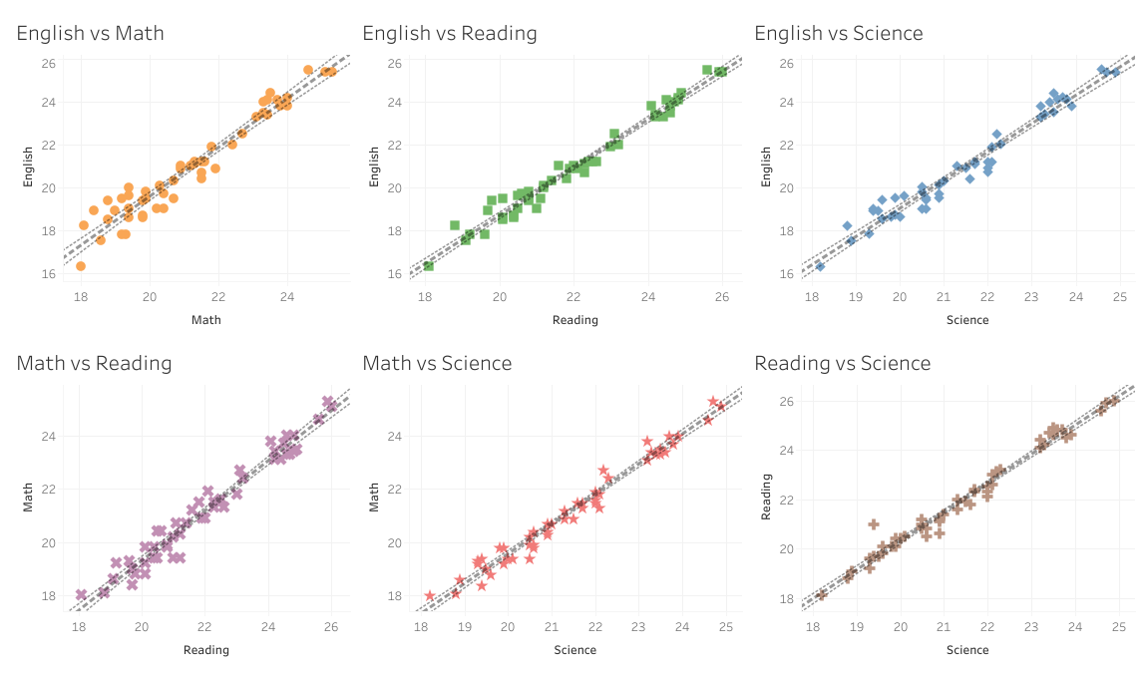
Results and observations: ACT
Graphed each score vs another score for ACT
Found positive correlation
Hypothesis: Smarter and/or more prepared test takers will receive higher scores across the board in all subjects

Slide 8
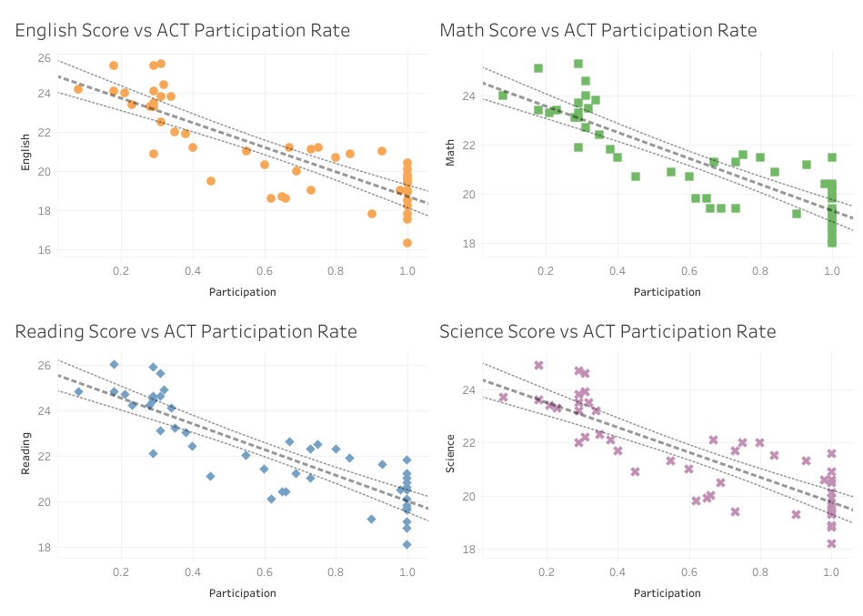
Results and Observations: ACT
When looking at participation rate and score, there is a negative correlation
Confidence is tighter on scores
New Hypothesis

Slide 9
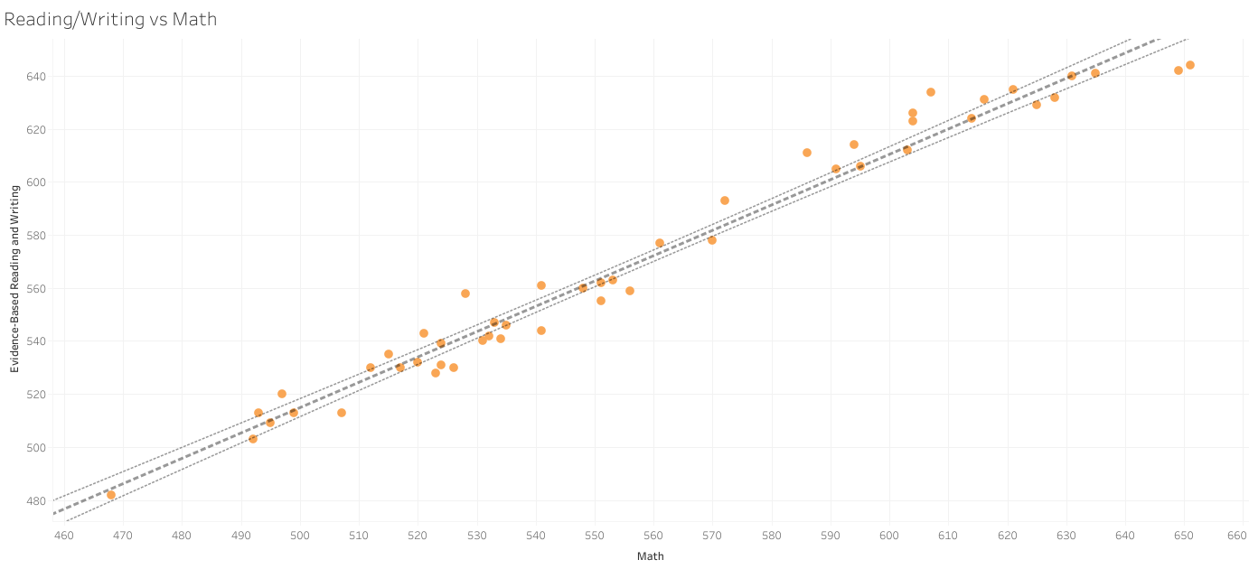
Results and observations: SAT
Again a positive correlation for
the score vs score, again confidence
is tighter

Slide 10
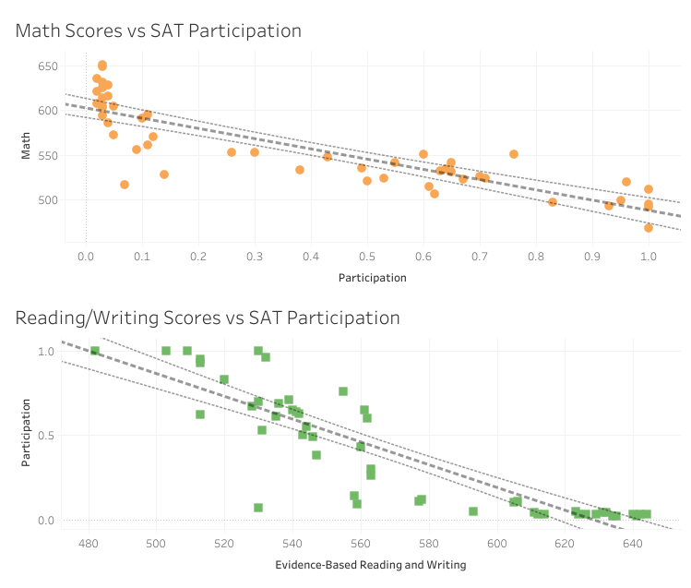
Results and observations: SAT
When looking at participation rate and score, there is a negative correlation
Confidence is tighter on scores
New Hypothesis!

Slide 11
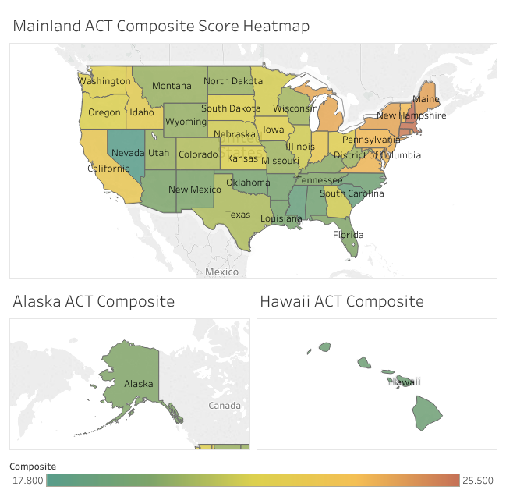
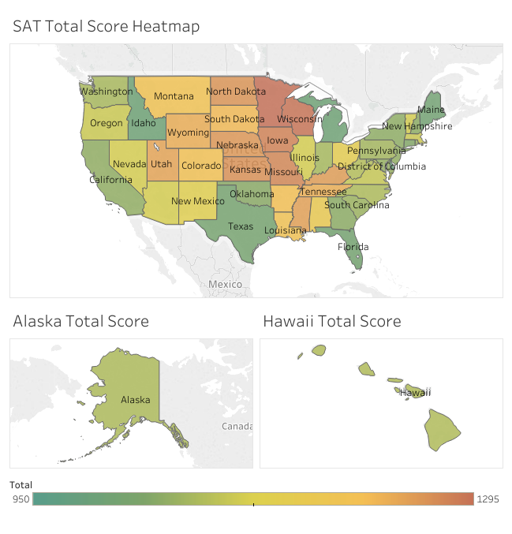

Slide 12
Questions?

